Slide 1
AI Chatbot Workshop
Presented for San Diego Mesa College CS Club

Slide 2
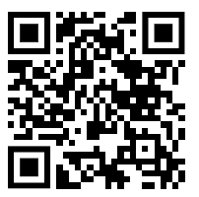
linkedin.com/in/aaroncayanan

Slide 3
Agenda

Slide 4
Introduction to GenAI
Building a chatbot with Python
Improving Design with Figma
Final version using React and Flask

Slide 5
Generative AI
what is it woah omg wows

Slide 6
What is GenAI?
Type of artificial intelligence that creates new content based on patterns from existing data.
Text, images, music.
Trained on large datasets, learns patterns, style, structures.

Slide 7
Why is it Important?
Content Generation - scripts, articles, etc.
Homework Help - math, coding, etc.
Allows for innovation

Slide 8
Challenges & Ethical Considerations
Bias & Fairness - AI models learn from human-created data, which can contain biases.
biased outputs
Copyright & Intellectual Property Concerns
often trained on copyrighted materials without explicit permission.
Deepfakes & Misinformation
can be misused for spam, fraud, and automated plagiarism.

Slide 9
What can we do?
AI is a Collaborator, Not a Replacement
meant to assist, not replace, human creativity.
AI is Creating New Opportunities
reshaping industries and creating new career paths.
Prompt Engineering / Applied AI
AI is Here to Help, Not to Take Over
Generative AI is a tool that amplifies human creativity, productivity, and innovation.

Slide 10
ChatGPT
ooooooh ahhhhhhhh

Slide 11

What is ChatGPT?
Developed by OpenAI based on the Generative Pre-trained Transformer (GPT) architecture.
Type of neural network design optimized for understanding and generating human language.
Trained on massive amounts of text data from the internet.
Goal:
Understand prompts and produce coherent, context-aware, and meaningful outputs.

Slide 12
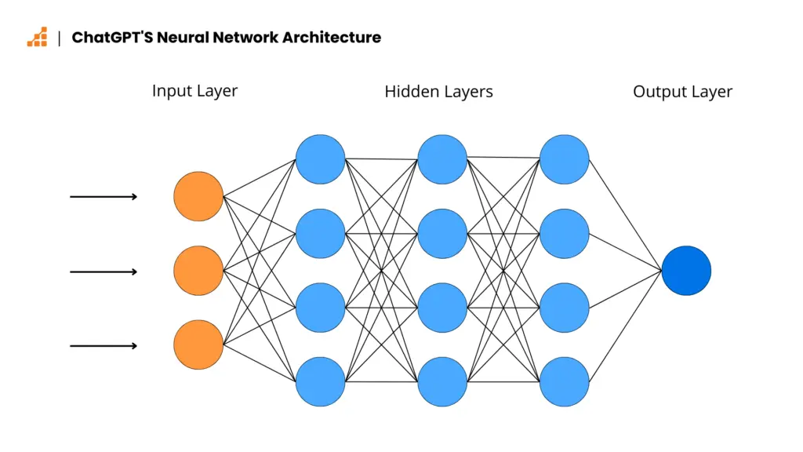
How Does ChatGPT Work?
Trains on huge datasets.
Learns patterns, language structures, and associations.

Slide 13
Why is GenAI Useful for Chatbots?
Natural Conversation Simulation
Context-Aware Responses
Scalable and Easily Deployable

Slide 14
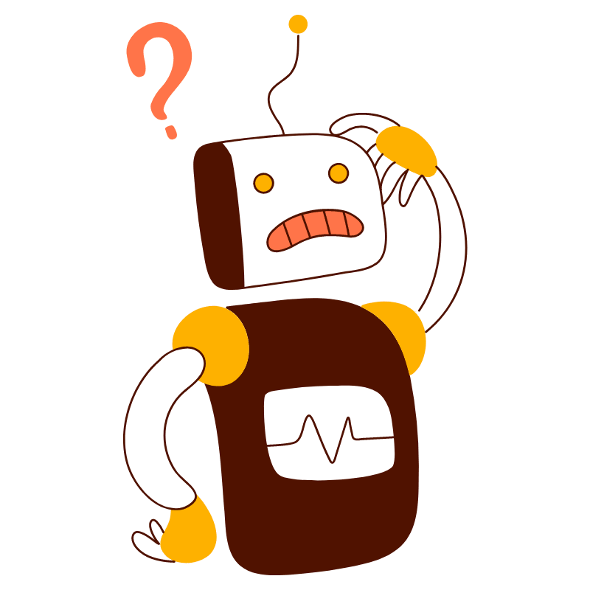
What is a Chatbot?
Designed to simulate conversations with humans.
Types of Chatbots
Rule-based Chatbots
AI-Powered Chatbots
User Input
Processing
Response Generation
Output

Slide 15
What is an API?
Definition: Application Programming Interface is a set of rules that allows two applications to communicate with each other. Acts as a bridge between systems or software.

Slide 16
think of it this way…

Slide 17
How to Access the Gemini API

Slide 18
Tkinter
woah so cool so magical

Slide 19
What is Tkinter?
Python’s standard GUI (Graphical User Interface) library
It provides tools to create desktop applications with windows, buttons, labels, and more.

Slide 20
building time.

Slide 21
CHALLENGE TIME

Slide 22
Coding Challenge: Make it your own!
Right now, this chatbot works — but it doesn’t have much personality. Your challenge is to add your own creative twist to either the main chat window or the response window. Make it more fun, more useful, or more you. There are no wrong answers!
IDEAS
Change the theme- make it space themed, old western, anything else you think is cool
Change colors, fonts, window titles
Show a random fun fact or a joke whenever a window opens
Add a secret easter egg
Give your bot personality!

